Slide 1
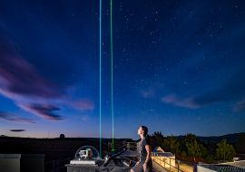
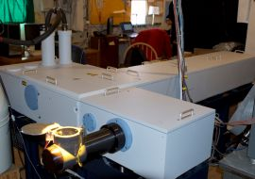
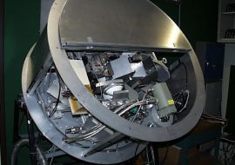
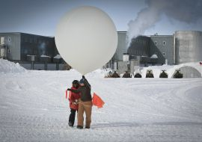
NDACC Lidar, where are we compared to µWave, Sonde, FTIR?
Notes:
Final slide - suggestion 2
Think about showing your E-mail address here

Slide 2
systems & activities
NDACC lidars measure
Ozone profiles (1 to 50 km)
Temperature profiles (15 to 90 km)
Aerosol profiles (2 to 30 km)
Water vapor profiles (1 to 12 km)
using lasers
NDACC sondes measure
Ozone profiles (0 to 30 km)
Temperature profiles (0 to 30 km)
Water vapor profiles (0 to 12/25 km)
Aerosol profiles (2 to 30 km)
using balloons
NDACC microwaves measure
Ozone Profiles (20 to 60 km)
ClO Profiles (Stratosphere)
H2O Profiles (25 to 80 km)
using atmospheric emissions
NDACC FTIRs measure
Ozone Profiles (4 layers)
HCl, ClONO2, ClO, CH4, N2O, HF, H2O, … (Columns)
using sunlight

Slide 3
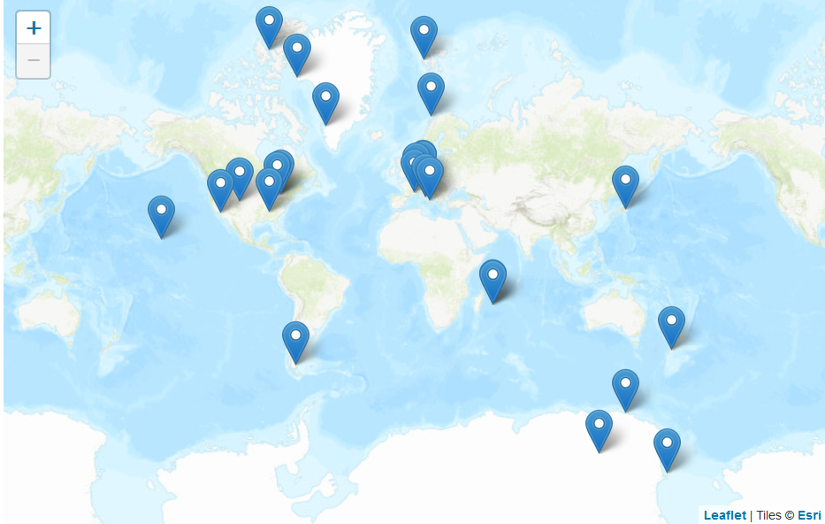
www.ndaccdemo.org
23 lidar stations

Slide 4
www.ndaccdemo.org
9 lidar stations submitted data since 1/1/2017 (43%)

Slide 5
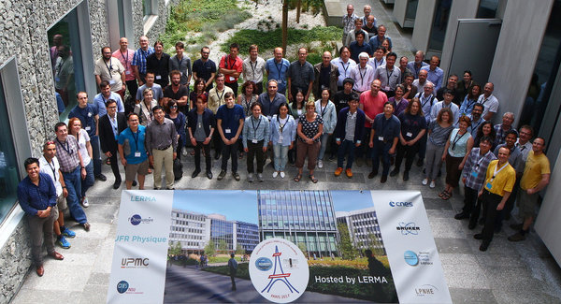
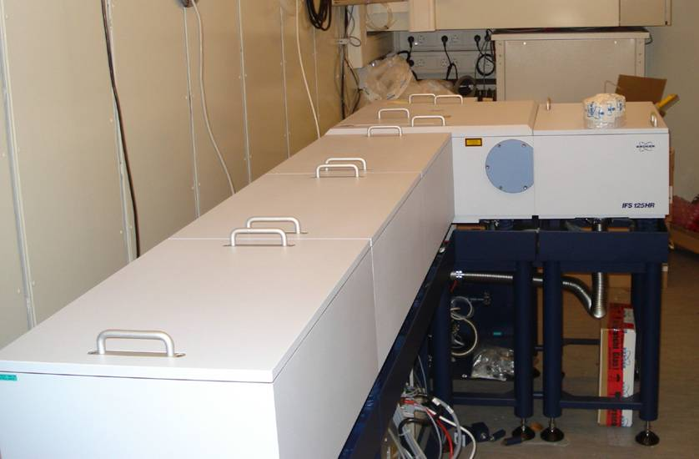
FTIR
FTIR WG meeting
Paris May 2017
Bruker
IFS 125 HR

Slide 6
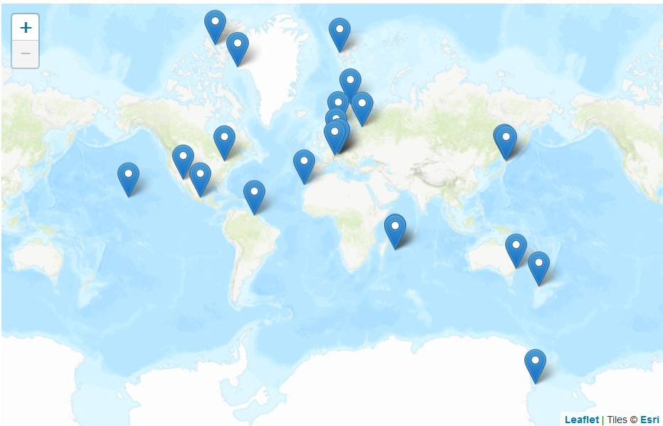
FTIR
21 FTIR stations

Slide 7
FTIR
18 FTIR stations submitted data since 1/1/2017 (86%)

Slide 8
µWave (Ozone)
µWave group = very small

Slide 9
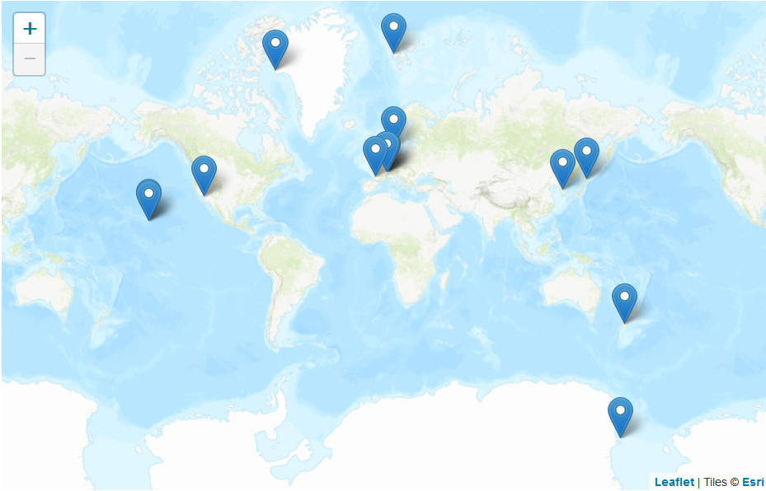
µWave (Ozone)
4 µWave stations submitted data since 1/1/2017 (80%)

Slide 10
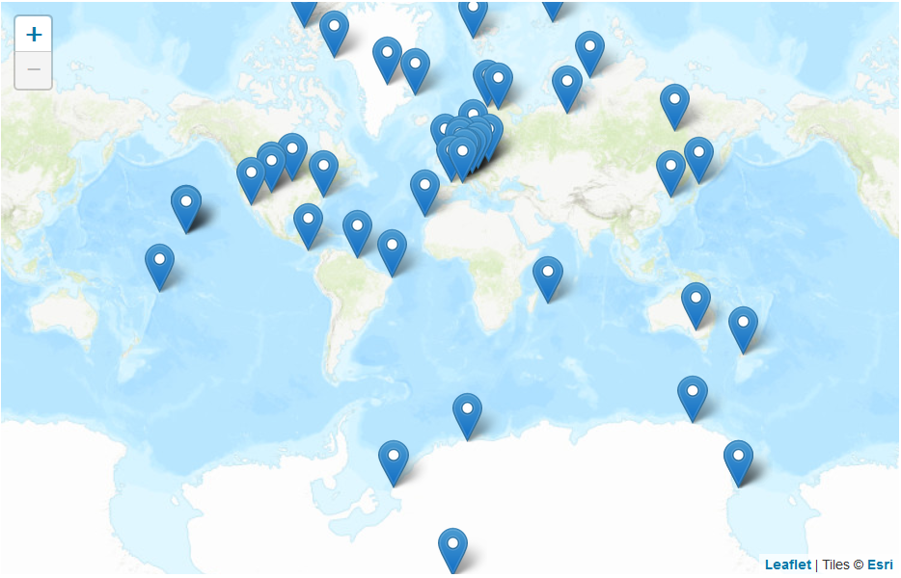
Sondes (Ozone)
15 stations submitted data since 1/1/2017 (30%?)

Slide 11
Sondes (Ozone)
Primary archives: WOUDC.ORG, NOAA-ESRL, SHADOZ
1500 / year @ 50/station = 30 stations ?

Slide 12
where do we stand ?
NDACC FTIRs
many sites, many species
high submission (hdf)
standard passive system
automatic & remote
large active working-group
NDACC sondes
many diverse sites, few species
good submission (woudc, …)
expensive (Met services)
some quality issues
old & slow working group
NDACC microwaves
few sites, few species
high submission (hdf & Ames)
automatic & remote, all weather
one man working group?
NDACC lidars
diverse sites, few species
low submission (for many sites)
complex active systems
medium working group

Slide 13
where do we stand ?
NDACC lidars
unique for strato+meso temperature
unique for aerosol
good for strato + tropo ozone
water vapor
competition
satellites, sondes, GRUAN
EARLINET, ACTRIS
sondes, satellites(?), FTIR, µWave
sondes, GRUAN
NDACC lidar difficulties
lasers (and funding)
long nights
processing & data submission
aging & retirements
what can we do
not much?
(semi-)automatic operation
share methods & code, simplify, use batch files & better software
train people, keep positions

Slide 14
successes
part of SPARC-LOTUS ozone profile trend activity
part of 2018 WMO/UNEP ozone assessment
Lauder lidar looking good again
Reunion / Maido established & looking good
Dome-C transition worked
ISSI-Bern uncertainty standardization
OHP intercomparison + more planned
Khaykin et al. aerosol time series
challenges
Andoya, Eureka, Rio Gallegos, Sondre Stromfjord, Tor Vergata, …
slow submission, hdf still not widespread, hdf-aerosol missing
aging & retirement
web-site move
perception of „same old“

Slide 15
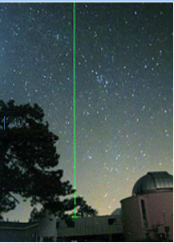
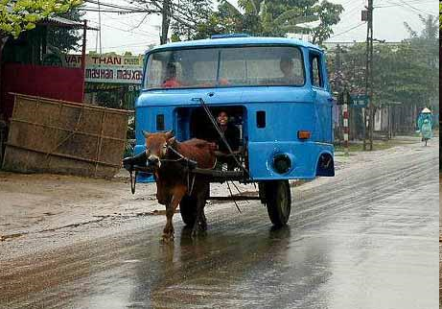
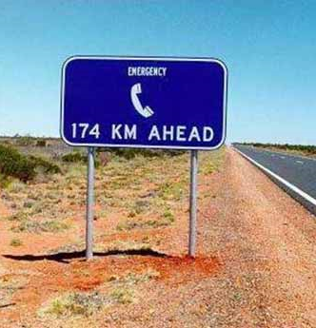
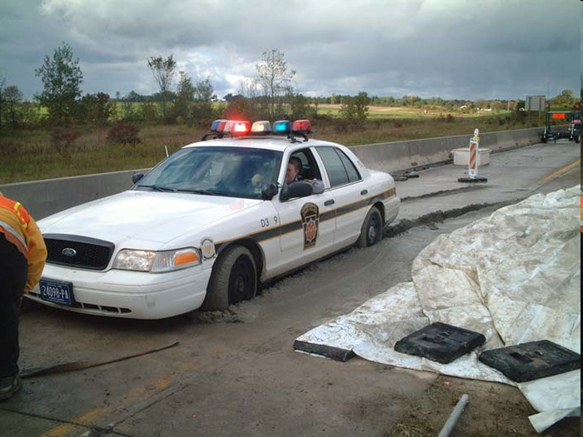
NDACC lidar working group
Your thoughts?
What should we do?
Priorities?

